Slide 1

101 in Web CTFs and Web Security
Cyber Skills Level-Up

Slide 2


$ whoami
Jian Shen (you guys can call me shen :D)
Work @ ProCheckUp
MCC 2023 Alumni
Likes to play CTFs (web)
M53 member
@shen1841

Slide 3

M53 ?
United Malaysian CTF team
Usually hang out here and play CTFs
Exchange ideas and solve challenges together
Sense of community
https://forms.gle/UDoMS9ksRt4S1VhV6

Slide 4

Why Web?
Better understanding of how the web works (web vulnerabilities, browser behaviour, defence mechanisms)
Enhance code review skill
Tackle and learn different kinds of web components (frameworks, languages, technologies)
Learn new attack vectors

Slide 5
What CTFs test you
Command of common web vulnerabilities
Command Injection
SQL Injection
Server-side Request Forgery (SSRF)
Cross Site Scripting (XSS)

Slide 6
What CTFs test you
Command of common web vulnerabilities
Proficiency in how the web works

Slide 7
What CTFs test you
Command of common web vulnerabilities
Proficiency in how the web works
Language specific quirks/behaviour

Slide 8
What CTFs test you
Command of common web vulnerabilities
Proficiency in how the web works
Language specific quirks/behaviour
Understanding of code used in libraries or frameworks

Slide 9
How do they test it?
Command of common web vulnerabilities
Proficiency in how the web works
Language specific quirks/behaviour
Understanding of code used in libraries or frameworks
Checking input against blacklists
Test by

Slide 10
How do they test it?
Command of common web vulnerabilities
Proficiency in how the web works
Language specific quirks/behaviour
Understanding of code used in libraries or frameworks
Checking input against blacklists
Using specific behaviour of web components
Test by

Slide 11
How do they test it?
Command of common web vulnerabilities
Proficiency in how the web works
Language specific quirks/behaviour
Understanding of code used in libraries or frameworks
Checking input against blacklists
Using specific behaviour of web components
Implementing controls/blockage
Test by

Slide 12
How do they test it?
Command of common web vulnerabilities
Proficiency in how the web works
Language specific quirks/behaviour
Understanding of code used in libraries or frameworks
Checking input against blacklists
Using specific behaviour of web components
Implementing controls/blockage
RTFM (Read The F*** Manual)
Test by

Slide 13
Identifying Sources & Sinks
Effective technique in quickly identifying attack points of the application
Might have done subconsciously/developed intuitively
Applicable to CTFs and any code review

Slide 14

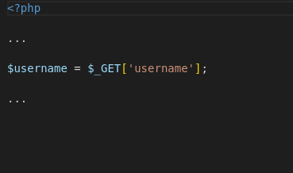
Source
Data origin
Focus on attacker-controlled sources
?username=value

Slide 15

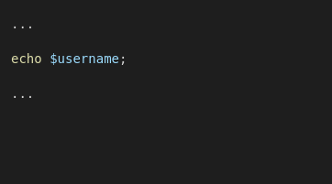
Sink
Places where data origin is fed into functions/code
Exploitable if attacker-controlled sources are fed into dangerous functions/exploitable regions of code
XSS
<img src=x onerror=alert(document.domain)>

Slide 16
Warmup Exercise
Consists of
Out-of-band exfiltration
Command Injection
Goal: cat /secret.txt
Source & Sink Identification
http://165.22.56.75:5010/

Slide 17
Out-of-band (OOB) Exfiltration
Application might not reflect/display indication of vulnerability
Use external servers to test vulnerabilities present
Use free webhooks (callback server) https://webhook.site/
Virtual Private Server (VPS)
ngrok (tunnel to localhost) https://ngrok.com/

Slide 18
Command Injection
Allows attackers to submit system commands to the website host operating system
Usage of dangerous functions such as :
PHP - system(),
Python - os.popen()
NodeJS – execSync()

Slide 19
Takeaways
Look out for dangerous functions such as system being used in CTFs, usually they are meant to be abused
Try different methods for data exfiltration such as (rev shell, webhook, etc)

Slide 20
Challenge 1
Consists of
SQL Injection
Blacklist
Goal: Login as admin
http://165.22.56.75:5011/login.php

Slide 21
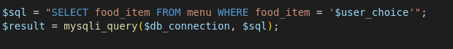
SQL Injection recap
Allows attackers to subvert SQL query logic
Happens when user input is directly concatenated with the original query
Defend with prepared statements
SQLi

Slide 22
SQL Injection recap
Allows attackers to subvert SQL query logic
Happens when user input is directly concatenated with the original query
Defend with prepared statements
SQLi
$user_choice => burger
SELECT food_item FROM menu WHERE food_item = ‘burger’

Slide 23
SQL Injection recap
Allows attackers to subvert SQL query logic
Happens when user input is directly concatenated with the original query
Defend with prepared statements
SQLi
$user_choice => burger’ OR 1=1;-- -
SELECT food_item FROM menu WHERE food_item = ‘burger’ OR 1=1;-- - ‘

Slide 24
Blacklists
Tries to filter out characters needed for exploitation
Might be incomplete and miss out specific bypass
Configured blacklist which has faults (not effective)
Might not have a bypass

Slide 25
Blacklists
Tries to filter out characters needed for exploitation
Might be incomplete and miss out specific bypass
Configured blacklist which has faults (not effective)
Might not have a bypass
Blacklist = [‘ ‘]
SELECT food_item FROM menu WHERE food_item = ‘burger’ OR 1=1;-- ‘

Slide 26
Example bypass
Replace spaces with comments /**/
https://portswigger.net/support/sql-injection-bypassing-common-filters
SELECT food_item FROM menu WHERE food_item = ‘burger’/**/OR/**/1=1;--/**/ ‘

Slide 27
Takeaways
Look out for SQL statements without prepared statements
Usually intended for abuse if author didn’t use them
Filters are often used as a blockage but not bulletproof

Slide 28
Challenge 2
Consists of
Server-side Request Forgery (SSRF)
Framework behaviour
Goal: Request /flag
http://165.22.56.75:5013/

Slide 29
Server-side Request Forgery
Allows the attacker to manipulate the server to perform requests to arbitrary endpoints
Valuable attack vector if the server can access unintended internal endpoints
Gain access to functionality that is not intended for the user

Slide 30
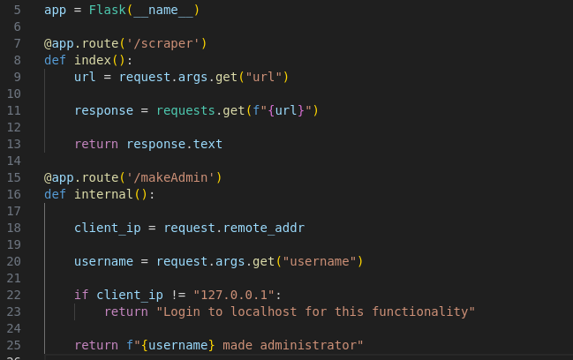
Server-side Request Forgery
/scraper endpoint can be abused to make any user an administrator by requesting /makeAdmin
Since the server itself is requesting the endpoint, the IP will be 127.0.0.1
?url=https://localhost/makeAdmin?username=attacker
Pass internal URL
Bypassed

Slide 31
Takeaways
If there are internal endpoints, heck if any functionality in the system allows you to perform SSRF
Always be wary of why code is written by the author, there might be a solution in there

Slide 32
Challenge 3
Consists of
JSON Web Token (JWT)
Read The F* Manual (RTFM)
Goal: Request /flag
http://165.22.56.75:5014/

Slide 33
JSON Web Token (JWT)
JWT is a form of session authentication
The token is encoded as base64
The token consists of 3 parts (header, data, signature)
The signature is signed with a private key, if the attacker knows the private key, they can tamper and escalate privileges
If the signature is invalid, the token is rejected

Slide 34
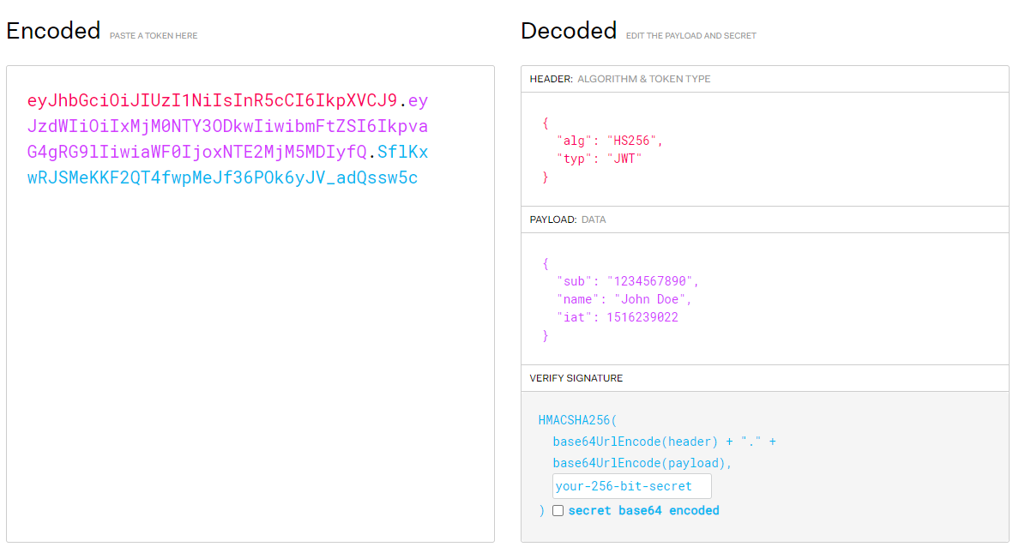
Structure of JWT
Header
https://jwt.io/

Slide 35
Structure of JWT
Data
https://jwt.io/

Slide 36
Structure of JWT
Signature
https://jwt.io/

Slide 37
RTFM (Read The F*** Manual)
Internet slang for a question that can be answered from reading the user manual
Used in CTFs when authors use suspicious functions or library code that is meant to be exploited/out of place
Users should read the manual regarding certain functions used in code to determine if it is exploitable

Slide 38
Takeaways
Always RTFM when dealing with code that you have not seen before or are unsure of
Always confirm if the function used is safe and not a misconfiguration

Slide 39
Challenge 4
Consists of
Blind SQL Injection
Web behaviour
Goal: Login as admin
Password length is 10 with only lowercase, uppercase and digits
http://165.22.56.75

Slide 40
Blind SQL Injection
Vulnerable to SQL injection but the application response does not directly reflect the injected values
Boolean based (True or False queries provides different output, i.e., 200 OK or Error)
Time based (Invoke a time delay based on queries)
Boolean
True, 200 OK
SELECT item_code from store where item_code = ‘KLM-392’ AND 1=1;-- - ‘

Slide 41
Blind SQL Injection
Vulnerable to SQL injection but the application response does not directly reflect the injected values
Boolean based (True or False queries provides different output, i.e., 200 OK or Error)
Time based (Invoke a time delay based on queries)
Boolean
True, 200 OK
SELECT item_code from store where item_code = ‘KLM-392’ AND 1=1;-- - ‘
SELECT item_code from store where item_code = ‘KLM-392’ AND 1=2;-- - ‘
False, 404 Not Found

Slide 42
Blind SQL Injection
Time based
Vulnerable to SQL injection but the application provides the same response (200 OK) regardless of successful or failed query
We will try to invoke a sleep command if a particular query is true and deduce from there
If a time delay has occurred from the response, we can be confident that the sleep command executed, and the condition we supplied is true

Slide 43
Blind SQL Injection
If not, then return 1
[3] Length
Time based
… ‘OR IF(substring((SELECT password from users WHERE BINARY username = ‘Joe’),1,1) = BINARY ‘p’, SLEEP(2),1);-- -’
[2] Start position
[1] String to extract
Substring to extract character
MySQL is case-insensitive, ‘a’ == ‘A’, BINARY to force case sensitive
If the first character of Joe’s password is ‘p’ then the database will sleep for 2 seconds

Slide 44
Takeaways
Always look out for SQL statements without prepared statements
SQL Injection is dangerous and can leak info even without returning content directly to the user
If code is out of place/weird, there could be a reason why

Slide 45
Thank You

